Slide 1


AI(Artificial Intelligence) II Semester Session 2024-25 Employee Salary Analysis
Rani Kumari (202410116100163)
Roopsi Srivastava (202410116100 173)
Rabita Yadav (202410116100 156)
Project Supervisor:
Ms. Komal salgotra
Assistant Professor

Slide 2
Content
Introduction
Data SET
Tools and Technologies used
Purpose of salary analysis
Salary distribution overview
Factors influencing salaries
Gender Pay Analysis
Salary Trends & key findings
Insights & Key Findings
Conclusion & Recommendations
Notes:
Font Styles: Times New Roman + Font Size: 25

Slide 3
Introduction
The goal of this project is to analyze employee salary data using Artificial Intelligence and Machine Learning techniques.
Helps in understanding salary patterns, predicting future salaries, and identifying disparities or inconsistencies in pay.
Notes:
Font Styles: Times New Roman + Font Size: 25

Slide 4
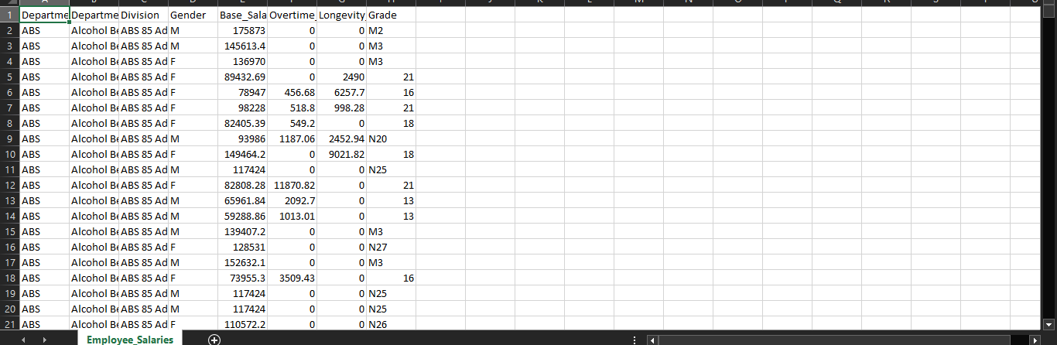
DATASET

Slide 5
TOOLS & TECHNOLOGIES USED
Languages: Python
Libraries: Pandas, NumPy, Scikit-learn, Matplotlib, Seaborn
Algorithms: Linear Regression, Random Forest, XGBoost
Visualization: Matplotlib & Seaborn

Slide 6
Purpose of Salary Analysis
Importance of Understanding Salary Trends
Key Factors Affecting Salaries
Internal HR Records
Market Salary Reports
Industry Standards
Government Databases
Notes:
Font Styles: Times New Roman + Font Size: 25

Slide 7
Salary Distribution Overview
Average Salary by Department
Median Salary Comparison
Salary Range and Variability
Graphical Representation
(Histogram/Bar Chart)
Notes:
Font Styles: Times New Roman + Font Size: 25

Slide 8
Factors Influencing Salaries
Job Role & Responsibilities
Geographic Location
Industry Trends
Performance & Skills
Education & Experience Level
Notes:
Font Styles: Times New Roman + Font Size: 25

Slide 9
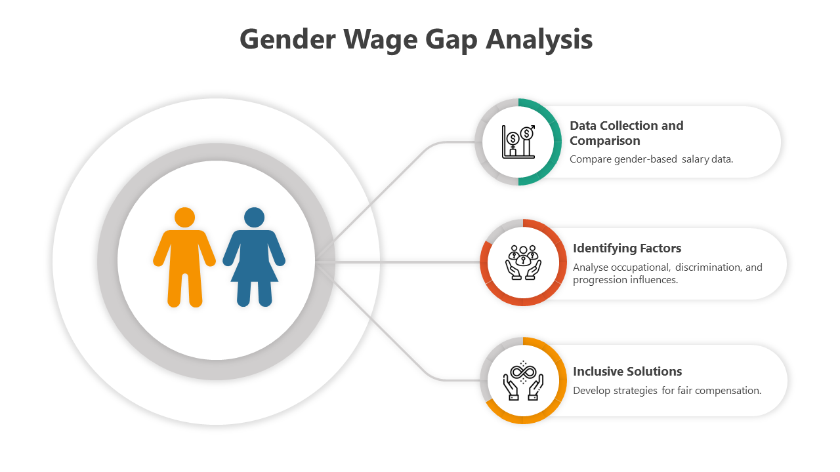
Gender Pay Gap Analysis
Comparison of Male vs. Female Salaries
Reasons Behind the Pay Gap
Strategies for Salary Equity
Response sent back to the user (Success/Failure)
Notes:
Font Styles: Times New Roman + Font Size: 25

Slide 10
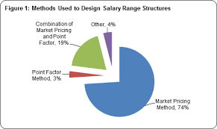
Salary Trends Over Time
Inflation Impact on Salaries
Future Salary Projections
Salary Growth by Year
Notes:
Font Styles: Times New Roman + Font Size: 25

Slide 11
Insights & Key Findings
.
Experience and education level are the most influential features.
Salaries increase steadily with years of experience.
Departmental pay gaps observed (e.g., IT > Support).
Identified outliers — some employees earn significantly above/below average.
Clustering reveals 3 distinct employee groups: Entry, Mid, and Senior level.
Notes:
Font Styles: Times New Roman + Font Size: 25

Slide 12
Conclusion & Recommendations
Summary of Findings
Recommendations for Salary Adjustments
HR & Management Strategies for Fair Compensation
Database Development
Notes:
Font Styles: Times New Roman + Font Size: 25

Slide 13
Thank You

